Slide 1
332:479 Concepts in VLSI
Design
Lecture 20
Testing Methods
Fault simulation
Automatic Test-Pattern Generation
  Random Pattern Generation
Sematech study
Design for testability – full scan design
Summary

Slide 2
Source:Essentials of Electronic Testing for Logic, Memory, and Mixed-Signal Circuits, by M. L. Bushnell and V. D. Agrawal, Kluwer Academic Press, 2000

Slide 3
Fault Simulation

Slide 4
Problem and Motivation
Fault simulation Problem: Given
    A circuit
    A sequence of test vectors
    A fault model
  Determine
    Fault coverage - fraction (or percentage) of modeled faults detected by test vectors
    Set of undetected faults
Motivation
    Determine test quality and in turn product quality
    Find undetected fault targets to improve tests

Slide 5
Fault Simulator in a VLSI Design Process
Verified design
netlist
Verification
input stimuli
Fault simulator
Test vectors
Modeled
fault list
Remove
tested faults
Test
compactor
Delete
vectors
Fault
coverage
?
Low
Test
generator
Add vectors
Adequate
Stop

Slide 6
Fault Simulation Scenario
Circuit model: mixed-level
    Mostly logic with some switch-level for high-impedance (Z) and bidirectional signals
    High-level models (memory, etc.) with pin faults
Signal states: logic
    Two (0, 1) or three (0, 1, X) states for purely Boolean logic circuits
    Four states (0, 1, X, Z) for sequential MOS circuits
Timing:
    Zero-delay for combinational and synchronous circuits
    Mostly unit-delay for circuits with feedback

Slide 7
Fault Simulation Scenario (continued)
Faults:
    Mostly single stuck-at faults
    Sometimes stuck-open, transition, and path-delay faults; analog circuit fault simulators are not yet in common use
    Equivalence fault collapsing of single stuck-at faults
    Fault-dropping -- a fault once detected is dropped from consideration as more vectors are simulated; fault-dropping may be suppressed for diagnosis
    Fault sampling -- a random sample of faults is simulated when the circuit is large

Slide 8
Serial Algorithm
Algorithm: Simulate fault-free circuit and save responses. Repeat following steps for each fault in the fault list:
    Modify netlist by injecting one fault
    Simulate modified netlist, vector by vector, comparing responses with saved responses
    If response differs, report fault detection and suspend simulation of remaining vectors
Advantages:
    Easy to implement; needs only a true-value simulator, less memory
    Most faults, including analog faults, can be simulated

Slide 9
Serial Algorithm (cont’d.)
Disadvantage: Much repeated computation; CPU time prohibitive for VLSI circuits
Alternative: Simulate many faults together
Test vectors
Fault-free circuit
Comparator
f1 detected?
Circuit with fault f1
Comparator
f2 detected?
Circuit with fault f2
Comparator
fn detected?
Circuit with fault fn

Slide 10
Summary
Fault simulator is an essential tool for test development.
Concurrent fault simulation algorithm offers the best choice.
For restricted class of circuits (combinational and synchronous sequential with only Boolean primitives), differential algorithm can provide better speed and memory efficiency (Section 5.5.6.)
For large circuits, the accuracy of random fault sampling only depends on the sample size (1,000 to 2,000 faults) and not on the circuit size. The method has significant advantages in reducing CPU time and memory needs of the simulator.

Slide 11
Combinational Automatic Test-pattern Generation
(ATPG)

Slide 12
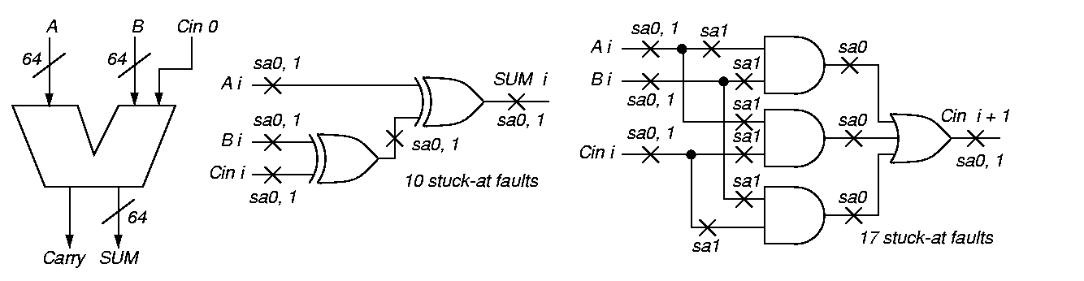
Functional vs. Structural ATPG

Slide 13
Carry Circuit

Slide 14
Functional vs. Structural
(continued)
Functional ATPG – generate complete set of tests for circuit input-output combinations
  129 inputs, 65 outputs:
  2¹²⁹ = 680,564,733,841,876,926,926,749,
214,863,536,422,912 patterns
  Using 1 GHz ATE, would take 2.15 x 10²² years
Structural test:
  No redundant adder hardware, 64 bit slices
  Each with 27 faults (using fault equivalence)
  At most 64 x 27 = 1728 faults (tests)
  Takes 0.000001728 s on 1 GHz ATE
Designer gives small set of functional tests – augment with structural tests to boost coverage to 98⁺ %

Slide 15
Definition of Automatic Test-Pattern Generator
Operations on digital hardware:
  Inject fault into circuit modeled in computer
  Use various ways to activate and propagate fault effect through hardware to circuit output
  Output flips from expected to faulty signal

Slide 16
Algorithm Completeness
Definition: Algorithm is complete if it ultimately can search entire binary decision tree, as needed, to generate a test
Untestable fault – no test for it even after entire tree searched
Combinational circuits only – untestable faults are redundant, showing the presence of unnecessary hardware

Slide 17
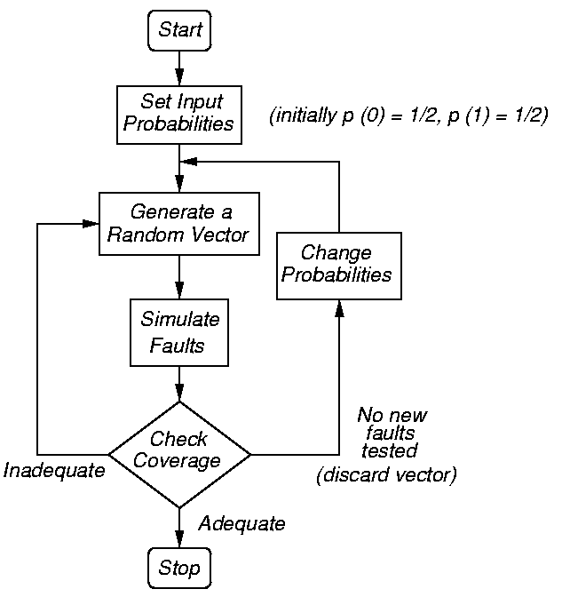
Random-Pattern Generation
Flow chart for method
Use to get tests for 60-80% of faults, then switch to D-algorithm or other ATPG for rest

Slide 18
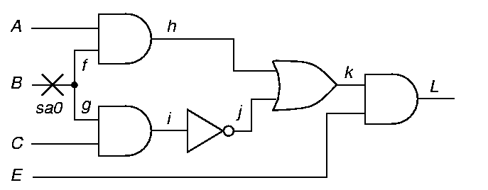
Path Sensitization Method Circuit Example
Fault Sensitization
Fault Propagation
Line Justification

Slide 19
Path Sensitization Method Circuit Example
Try path f – h – k – L blocked at j, since there is no way to justify the 1 on i
1
D
1/0
D
D
1/0
1/0
D
1/1
1
D
0
1
1/1
0/0
1/?
1

Slide 20
Path Sensitization Method Circuit Example
Try simultaneous paths f – h – k – L and
g – i – j – k – L blocked at k because D-frontier (chain of D or D) disappears
1
D
1/1
1/0
D
1/0
1
1
1/1
1/1
D
D
1/0
D
0/1
1/0
1/1

Slide 21
Path Sensitization Method Circuit Example
Final try: path g – i – j – k – L – test found!
0
0/0
0/0
0
D
1/0
1/1
D
1
1/0
1/0
D
1/0
D
0/1
D
1/1
1
1
1/1

Slide 22
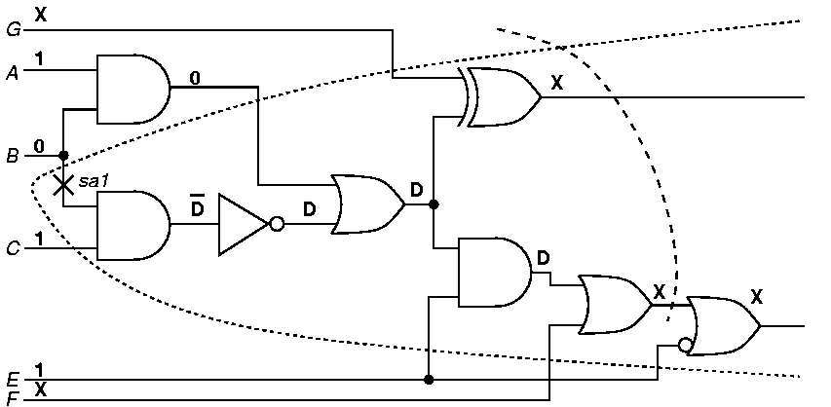
Fault Cone and D-frontier
Fault Cone -- Set of hardware affected by fault
D-frontier – Set of gates closest to POs with fault effect(s) at input(s)
D-frontier
Fault Cone

Slide 23
Sematech (Industry) Results
Data for devices failing some, but not all, tests:
  Stuck-at, functional, IDDQ (current), delay
  No single testing method finds all bad chips
IDDQ (5 μA limit)
pass
14
6
52
pass
pass
6
0
1
36
fail
fail
1463
34
13
1251
pass
fail
7
1
8
fail
pass
fail
pass
fail
pass
pass
fail
fail
Scan-based Stuck-at
Scan-based delay
Functional

Slide 24
DESIGN FOR TESTABILITY
Scan Design

Slide 25
Definition
Design for testability (DFT) refers to those design techniques that make test generation and test application cost-effective.
DFT methods for digital circuits:
  Ad-hoc methods
  Structured methods:
    Scan
    Partial Scan
    Built-in self-test (BIST)
    Boundary scan
DFT method for mixed-signal circuits:
    Analog test bus

Slide 26
Ad-Hoc DFT Methods
Good design practices learnt through experience are used as guidelines:
    Avoid asynchronous (unclocked) feedback.
    Make flip-flops initializable.
    Avoid redundant gates. Avoid large fanin gates.
    Provide test control for difficult-to-control signals.
    Avoid gated clocks.
    . . .
    Consider ATE requirements (tristates, etc.)
Design reviews conducted by experts or design auditing tools.
Disadvantages of ad-hoc DFT methods:
    Experts and tools not always available.
    Test generation is often manual with no guarantee of high fault coverage.
    Design iterations may be necessary.

Slide 27
Scan Design
  Circuit is designed using pre-specified design rules.
  Test structure (hardware) is added to the verified design:
    Add a test control (TC) primary input.
    Replace flip-flops by scan flip-flops (SFF) and connect to form one or more shift registers in the test mode.
    Make input/output of each scan shift register controllable/observable from PI/PO.
  Use combinational ATPG to obtain tests for all testable faults in the combinational logic.
  Add shift register tests and convert ATPG tests into scan sequences for use in manufacturing test.

Slide 28
Scan Design Rules
Use only clocked D-type of flip-flops for all state variables.
At least one PI pin must be available for test; more pins, if available, can be used.
All clocks must be controlled from PIs.
Clocks must not feed data inputs of flip-flops.

Slide 29
Scan Flip-Flop (SFF)
D
Master latch
Slave latch
TC
Logic
overhead
Q
MUX
SD
Q
CK
D flip-flop
CK
Master open
Slave open
t
TC
Normal mode, D selected
Scan mode, SD selected
t

Slide 30
Level-Sensitive Scan-Design Flip-Flop (LSSD-SFF)
Master latch
Slave latch
D
Q
MCK
Q
SCK
D flip-flop
SD
MCK
Normal
mode
Logic
overhead
TCK
TCK
MCK
Scan
mode
TCK
SCK
t

Slide 31
Adding Scan Structure
PI
PO
Combinational
logic
SFF
SCANOUT
SFF
SFF
TC or TCK
Not shown: CK or
MCK/SCK feed all
SFFs.
SCANIN

Slide 32
Comb. Test Vectors
I1
I2
O1
O2
PI
PO
SCANIN
TC
Combinational
logic
SCANOUT
S1
S2
N1
N2
Present
state
Next
state

Slide 33
Comb. Test Vectors
I1
I2
Don’t care
or random
bits
PI
SCANIN
S1
S2
TC
0 0 0 0 0 0 0 1 0 0 0 0 0 0 0 1 0 0 0 0 0 0 0
O1
O2
PO
SCANOUT
N1
N2
Sequence length = (n_{comb} + 1) n_{sff} + n_{comb} clock periods
n_{comb} = number of combinational vectors
n_{sff} = number of scan flip-flops

Slide 34
Testing Scan Register
Scan register must be tested prior to application of scan test sequences.
A shift sequence 00110011 . . . of length n_{sff}+4 in scan mode (TC=0) produces 00, 01, 11 and 10 transitions in all flip-flops and observes the result at SCANOUT output.
Total scan test length: (n_{comb} + 2) n_{sff} + n_{comb} + 4 clock periods.
Example: 2,000 scan flip-flops, 500 comb. vectors, total scan test length ~ 10⁶ clocks.
Multiple scan registers reduce test length.

Slide 35
Scan Overheads
IO pins: One pin necessary.
Area overhead:
  Gate overhead = [4 n_{sff}/(n_{g}+10n_{ff})] x 100%, where n_{g} = comb. gates; n_{ff} = flip-flops; Example – n_{g} = 100k gates, n_{ff} = 2k flip-flops, overhead = 6.7%.
  More accurate estimate must consider scan wiring and layout area.
Performance overhead:
  Multiplexer delay added in combinational path; approx. two gate-delays.
  Flip-flop output loading due to one additional fanout; approx. 5-6%.

Slide 36
ATPG Example: S5378
Original
2,781
179
0
0.0%
4,603
35/49
70.0%
70.9%
5,533 s
414
414
Full-scan
2,781
0
179
15.66%
4,603
214/228
99.1%
100.0%
5 s
585
105,662
Number of combinational gates
Number of non-scan flip-flops (10 gates each)
Number of scan flip-flops (14 gates each)
Gate overhead
Number of faults
PI/PO for ATPG
Fault coverage
Fault efficiency
CPU time on SUN Ultra II, 200MHz processor
Number of ATPG vectors
Scan sequence length

Slide 37
Summary
Scan is the most popular DFT technique:
    Rule-based design
    Automated DFT hardware insertion
    Combinational ATPG
Advantages:
    Design automation
    High fault coverage; helpful in diagnosis
    Hierarchical – scan-testable modules are easily combined into large scan-testable systems
    Moderate area (~10%) and speed (~5%) overheads
Disadvantages:
    Large test data volume and long test time
    Basically a slow speed (DC) test

Slide 38
Summary
Fault simulation
Automatic Test-Pattern Generation
  Random Pattern Generation
Sematech study
Design for testability – full scan design

